Slide 1





C++ Set-Up for Algo Quant Trading
By Nicholas Burgess

Slide 2

C++ Set-Up for Algo Quant Trading
Part 1 – Visual Studio for Windows
Online C++ Emulators & Code Snippets
Visual Studio Projects & Solutions
C++ Building, Compilation & Linking
Part 2 – CMake for Cross-platform Builds
The CMake Build System
How to use CMake
Build Environments & Compilers
Example: Visual Studio & CMake https://github.com/nburgessx/QuantResearch/tree/main/CMake%20Examples

Slide 3
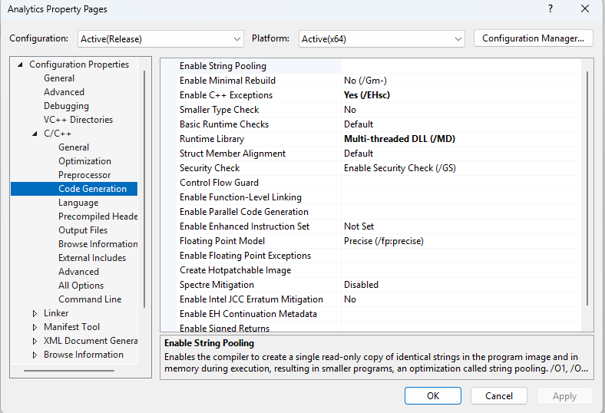
Application Binary Interface (ABI)
ABI defines how project binaries are linked and how they manage memory
Projects sharing runtime resources e.g. std::vector or FILE* must use the same C++ Runtime library (CRT), which handles memory, I/O and startup support
Dynamic Linkage (/MD) links against a shared C++ Runtime DLL (CRT)
Static Linkage (/MT) embeds a private CRT into each binary
Mixing /MD and /MT is unsafe – such code often builds successfully but fails and crashes at runtime
Rule of thumb:
/MD → DLLs & large apps (shared runtime, one-heap)
/MT → Fully self-contained tools (no shared ownership)

Slide 4
Visual Studio

Slide 5
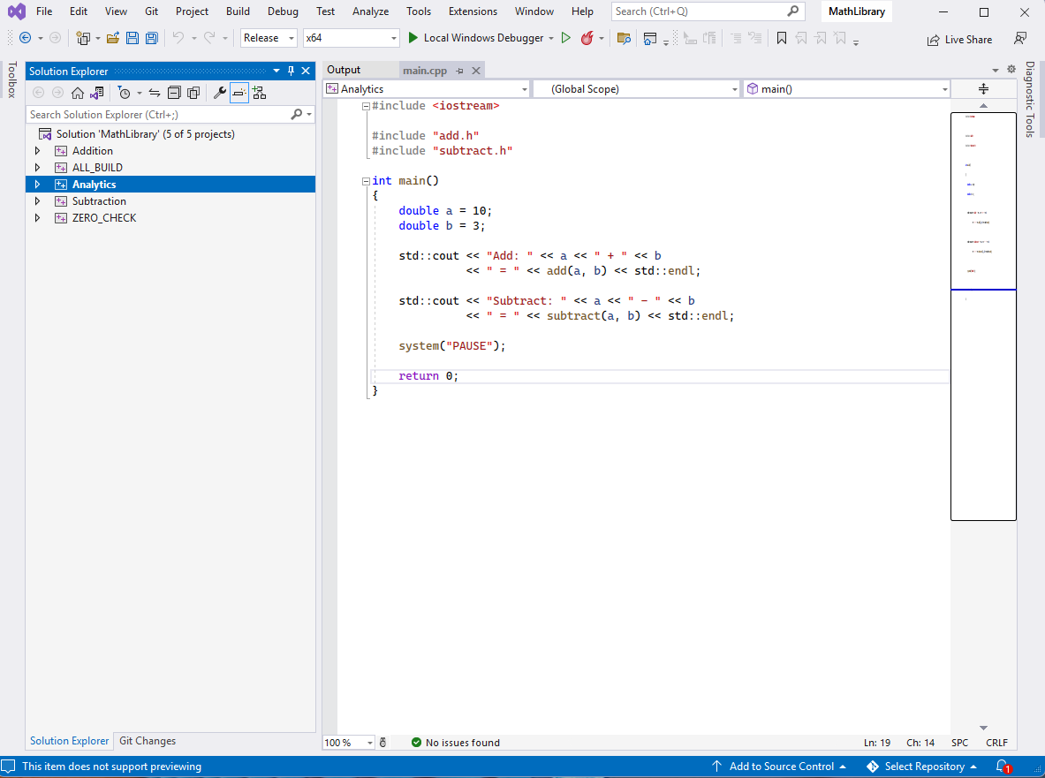
Visual Studio
Solution File
Start-Up Project
Project Dependencies (Build Order)
Configuration
Debug, Release, Custom
Can Include/Exclude Projects
Project Files
Independent Code Project Groups
Features
Source Control – Git Integration
Command Line – Dev Command Prompt
External Tools – Custom Tools / Scripts
Extensions – e.g. Incredibuild

Slide 6
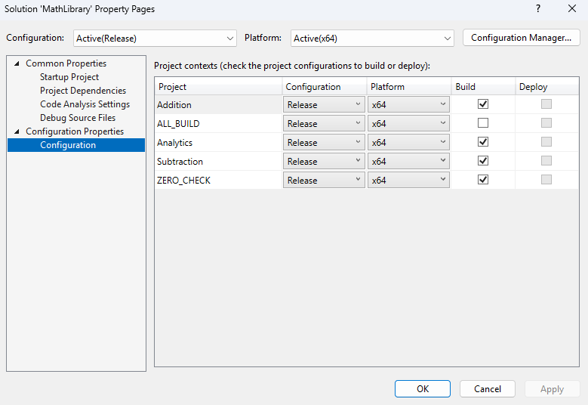
Visual Studio Solution & Projects Files These are XML files in disguise – Try opening them in notepad!

Slide 7
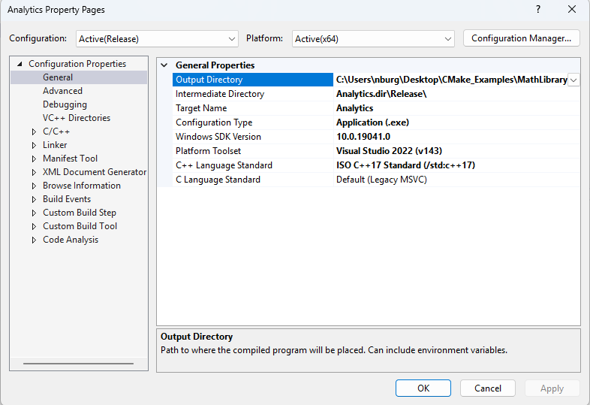
Visual Studio Project Properties
Output type
Configuration Type (.lib | .exe | .dll)
Where outputs go
Intermediate Directory (.obj)
Output Directory (.lib | .exe | .dll)
Solution and Project Files [TOP TIP]
These are XML files that can be opened in Notepad
XML supports extra features e.g. recursive file paths

Slide 8
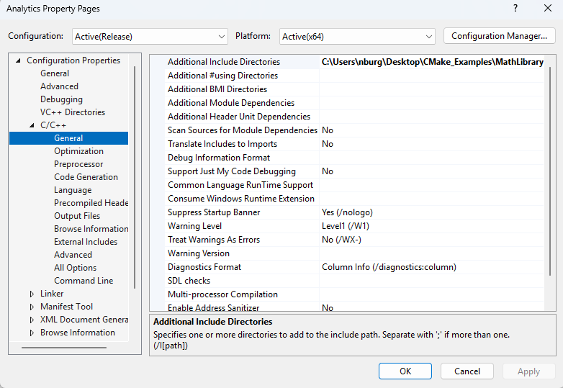
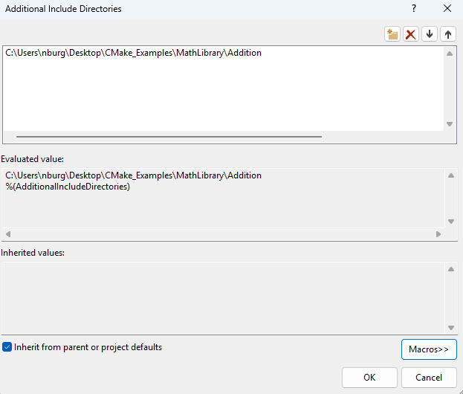
VS Project Properties – C/C++ Compiler
File Path Macros [TOP TIP]
Click the down arrow on any directory folder, then in the window pop-up press the “Macros” button
View existing file path variables (macros) and/or add new ones e.g. $(SolutionDir), $(ProjectDir), …

Slide 9
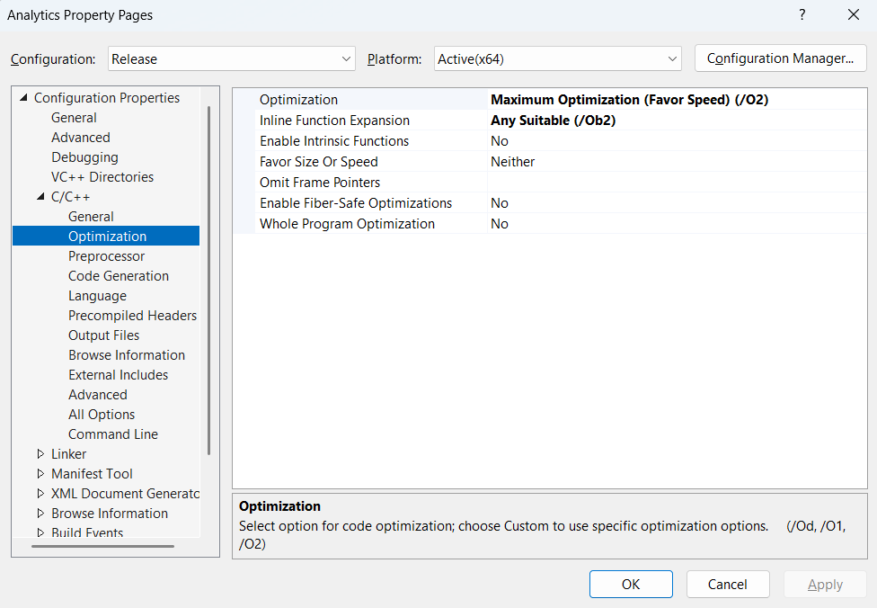
VS Project Properties – C/C++ Compiler

Slide 10
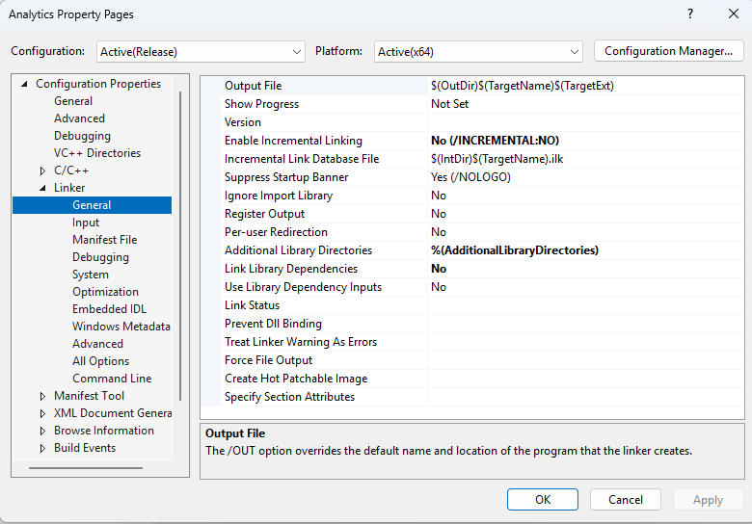
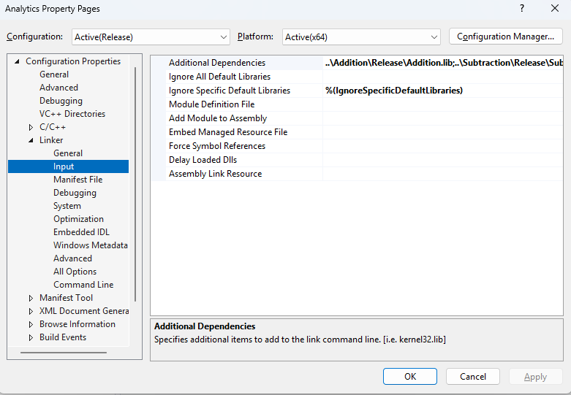
VS Project Properties – Linker/Librarian

Slide 11
Summary – Key Project Properties
General
Output Directory – Specify output path
Configuration Type – Specify the output file type .lib, .exe or .dll
C++ Language Standard – C++14, C++17, C++20 …
C/C++ → General
Additional Include Directories – To link projects, add include folder(s) here
Debug Information Format – Edit and Continue (/ZI) this allows us to make minor modifications with out rebuilding the project
Multi-processor Compilation (Yes /MP) – allows parallel building of .cpp files
C/C++ → Code Generation
Enable C++ Exceptions – /Ehsc allows structured exception handling and helps prevent crashes
Runtime Library – Here we must specify dynamic or static linking of CRT (/MD or /MT), defaults to /MD
Linker → General:
Additional Library Directories - To link projects, add path to .lib files here
Linker → Input:
Additional Dependencies – To link projects, specify .lib path here
Linker → Debugging
Generate Debug Info – To test and debug a release project select /DEBUG

Slide 12
CMake Build Framework

Slide 13

CMake Cross-Platform Build System
CMake – What it is and what it does
A cross-platform build system – not a compiler
It uses platform-independent configuration files, CMakeLists.txt
Generates native build files e.g. Visual Studio Solutions, Linux Make files, Ninja files, macOS Xcode projects
Available as part of Visual Studio, see Tools -> Command line -> Developer Command Prompt
How to generate the solution File using Visual Studio?
Create the necessary CMakeLists.txt files
Open Visual Studio command line and type:

Slide 14
CMake Config Files – CMakeLists.txt
Creating CMakeLists.txt Files – A summary of main CMake commands
Solution Config File
Name the solution file (project) and specify what projects to include (add_subdirectory)
Project Config Files
Name the project and list the .h and .cpp files to include (add_library | add_executable)
We provide the path to the include folder(s) with our header files (target_include_directories)
List any dependency projects to include (target_link_libraries)

Slide 15
Example Cake Solution G
CMake – What it is and what it does
A cross-platform build system – not a compiler
It uses platform-independent configuration files, CMakeLists.txt
Generates native build files e.g. Visual Studio Solutions, Linux Make files, Ninja files, macOS Xcode projects
Available as part of Visual Studio, see Tools -> Command line -> Developer Command Prompt
How to generate the solution File using Visual Studio?
Create the necessary CMakeLists.txt files
Open Visual Studio command line and type:

Slide 16
Example: Create Solution File
Consider a simple C++ maths library where the main project is called Analytics that depends on two projects named Addition and Subtraction. The folder structure looks as follows,
MathLibrary (Root Folder)
CMakeLists.txt
Analytics
CMakeLists.txt | Main.cpp
Addition
CMakeLists.txt | Add.h | Add.cpp
Subtraction
CMakeLists.txt | Subtract.h | Subtract.cpp
The solution root folder and each project folder requires a CMakeLists.txt config file
The config file defines the project type, include paths and project dependencies

Slide 17
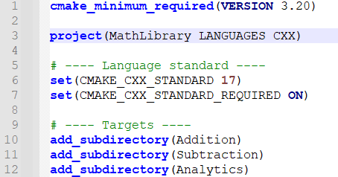
Solution Config File, CMakeLists.txt
project – Name of the solution file
add_subdirectory – List project folders to include

Slide 18
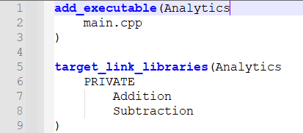
Main Project Config File, CMakeLists.txt
add_executable
Creates project that outputs an executable called Analytics.
List all the .h and .cpp files to include.
add_subdirectory
List the project name then the dependency projects to include
Here we add the addition and subtraction projects to the analytics project

Slide 19
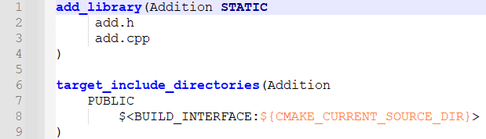
Dependency Project Config File, CMakeLists.txt
add_library
Creates a project named Addition. Use STATIC to generate a .lib and SHARED to generate a .dll
List all the .h and .cpp files to include.
target_include_directories
List the include directories for the Addition project
$(CMAKE_CURRENT_SOURCE_DIR) means use the current folder

Slide 20
Generating the Visual Studio Solution File
How to generate the solution File using Visual Studio?
Create the necessary CMakeLists.txt files
Open Visual Studio command prompt and navigate to the solution root folder
Type mkdir build to create a folder called ‘build’
Navigate to the build folder cd build
To generate the solution file type: cmake –G “Visual Studio 17 2022” ..
Note “..” means the root project is up one folder level
How to generate the native build projects on non-windows platforms and compilers?
Change the name of the compiler from “Visual Studio 17 2022” to the compiler of your choice
Examples: For Linux “Unix Makefiles” or “Ninja” and for macOS use “Xcode”

Slide 21
CMake Resources

Slide 22

Getting Started with CMake
Professional C++ with CMake
Outlines how professional Quants use CMake
Includes canonical stylized working examples
Intentionally simple and easy to follow
Link: https://algoquanthub.beehiiv.com/p/professional-c-with-cmake-for-quants-algo-trading
Examples: https://github.com/nburgessx/QuantResearch/tree/main/CMake%20Examples

Slide 23
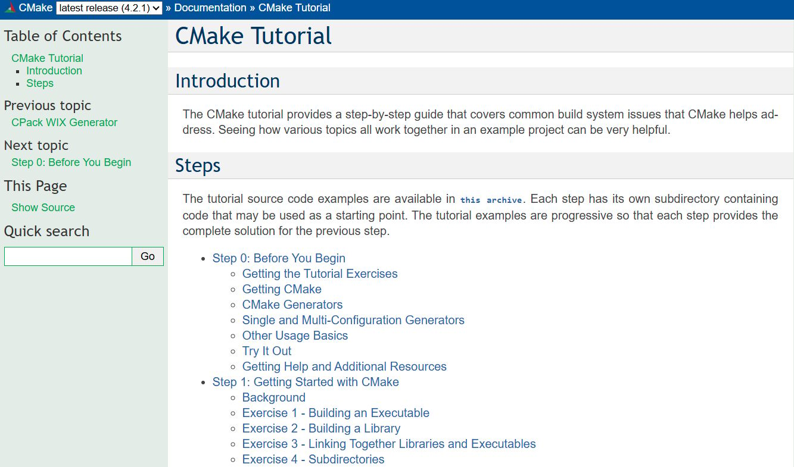
CMake Tutorial – cmake.org
CMake Tutorial – cmake.org
Provides a step-by-step guides and tutorials on how to use CMake

Slide 24

Professional CMake
Professional CMake – A Practical Guide
Free Book
By Craig Scott
https://crascit.com/professional-cmake/

Slide 25
More Info …

Slide 26




Subscribe to my Quant Newsletter
https://algoquanthub.beehiiv.com/subscribe
Subscribe to my Quant YouTube Channel
https://www.youtube.com/@algoquanthub
Algo Trading & Quant Store
https://payhip.com/AlgoQuantHub
Follow me on LinkedIn
https://www.linkedin.com/in/nburgessx

Slide 27
Contact
Have questions or want further info?
LinkedIn: www.linkedin.com/in/nburgessx

